Slide 1
Exam 70-777 Implementing Microsoft Azure Cosmos DB Solutions
Partition and Model Data
Replicate Data Across the World
Tune and Debug Azure Cosmos DB Solutions
Perform Integration and Develop Solutions
Mohd Mishal
Cloud Solutions Consultant
MCT
https://www.microsoft.com/en-ie/learning/exam-70-777.aspx
Notes:
20533D
1: Introduction to Microsoft Azure

Slide 2
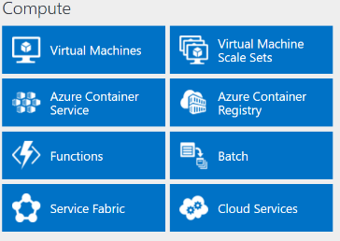
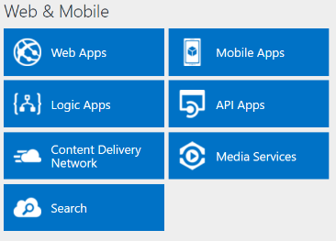
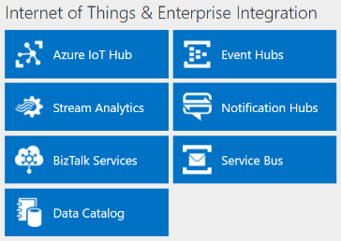
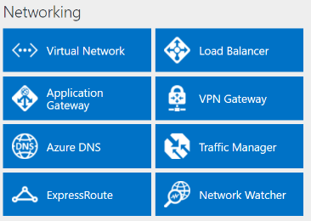
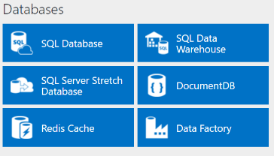
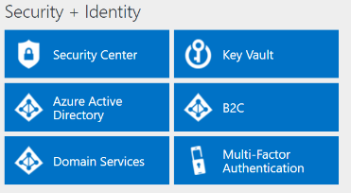
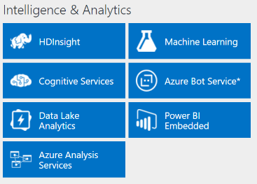
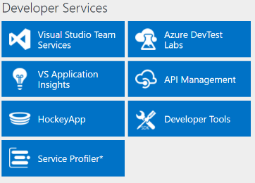
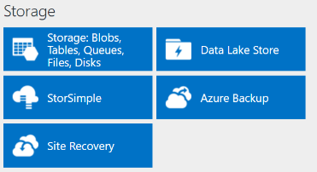
http://azureplatform.azurewebsites.net/
* Preview Services
Notes:
Preview Version 1.7 (2017-04-20)

Slide 3
Partition and Model Data
Plan a partitioning strategy
Model data based on business use cases
https://www.microsoft.com/en-ie/learning/exam-70-777.aspx

Slide 4
Partition and Model Data
Plan a partitioning strategy
Select a partition key for a container; differentiate between partition keys and partition key ranges; partition data across multiple containers; calculate throughput distribution across partition key ranges; control cross-partition queries; plan for transactions
Model data based on business use cases
Identify when to co-locate data within the same container or across multiple containers; identify when to co-locate data within the same partition key or across multiple partition keys; identify when to co-locate data within the same document or across multiple documents; share properties between documents
https://www.microsoft.com/en-us/learning/exam-70-777.aspx
Notes:
The following topics are not included in this presentations due to time constrains

Slide 5
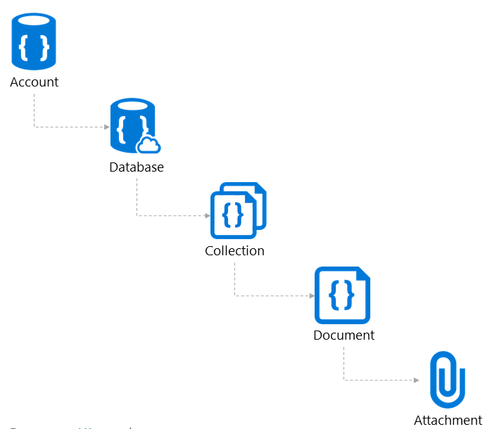

Resource Model

Slide 6
Resource Model
Account
Database
Container
Item
https://docs.microsoft.com/en-us/azure/cosmos-db/sql-api-resources
Notes:
A tenant of the Cosmos DB service starts by provisioning a database account. A database account manages one or more databases. A Cosmos DB database manages users, permissions and containers. A Cosmos DB resource container is a schema-agnostic container of arbitrary user-generated JSON items and JavaScript based stored procedures, triggers and user-defined-functions (UDFs). Entities under the tenant’s database account – databases, users, permissions, containers etc. are referred to as resources.
Each resource is uniquely identified by a stable and logical URI and represented as a JSON document. The overall resource model of an application using Cosmos DB is a hierarchical overlay of the resources rooted under the database account, and can be navigated using hyperlinks. Except for the item resource, which is used to represent arbitrary user defined JSON content, all other resources have a system-defined schema.
Container and item resources are further projected as reified resource types for a specific type of API interface. For example, while using document-oriented APIs, container and item resources are projected as collection (container) and document (item) resources, respectively; likewise, for graph-oriented API access, the underlying container and item resources are projected as graph (container), node (item) and edge (item) resources respectively; while accessing using a key-value API table (container) and item/row (item) are projected.

Slide 7


********.azure.com
Account
Database
IGeAvVUp …
Container
Item
Notes:
A tenant of the Cosmos DB service starts by provisioning a database account. A database account manages one or more databases. A Cosmos DB database manages users, permissions and containers. A Cosmos DB resource container is a schema-agnostic container of arbitrary user-generated JSON items and JavaScript based stored procedures, triggers and user-defined-functions (UDFs). Entities under the tenant’s database account – databases, users, permissions, containers etc. are referred to as resources.
Each resource is uniquely identified by a stable and logical URI and represented as a JSON document. The overall resource model of an application using Cosmos DB is a hierarchical overlay of the resources rooted under the database account, and can be navigated using hyperlinks. Except for the item resource, which is used to represent arbitrary user defined JSON content, all other resources have a system-defined schema.
Container and item resources are further projected as reified resource types for a specific type of API interface. For example, while using document-oriented APIs, container and item resources are projected as collection (container) and document (item) resources, respectively; likewise, for graph-oriented API access, the underlying container and item resources are projected as graph (container), node (item) and edge (item) resources respectively; while accessing using a key-value API table (container) and item/row (item) are projected.

Slide 8
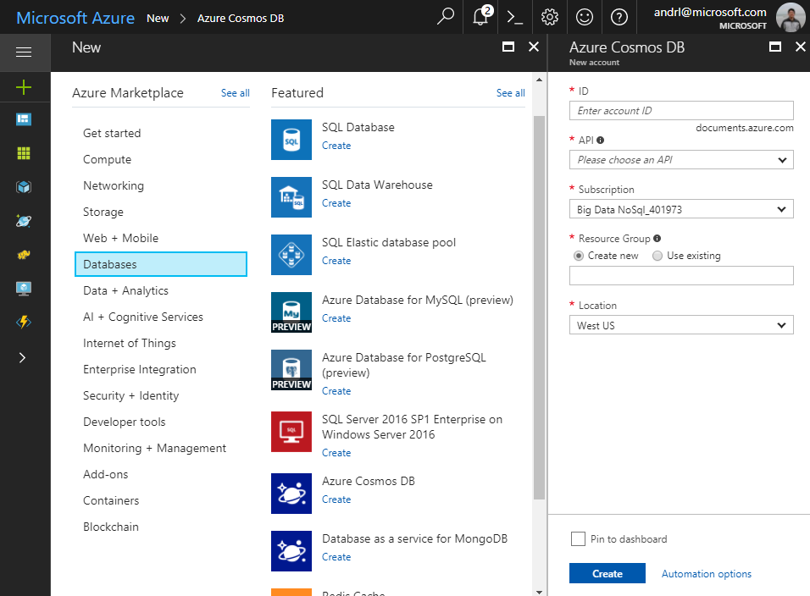
Account
Database
Container
Item
Notes:
A tenant of the Cosmos DB service starts by provisioning a database account. A database account manages one or more databases. A Cosmos DB database manages users, permissions and containers. A Cosmos DB resource container is a schema-agnostic container of arbitrary user-generated JSON items and JavaScript based stored procedures, triggers and user-defined-functions (UDFs). Entities under the tenant’s database account – databases, users, permissions, containers etc. are referred to as resources.
Each resource is uniquely identified by a stable and logical URI and represented as a JSON document. The overall resource model of an application using Cosmos DB is a hierarchical overlay of the resources rooted under the database account, and can be navigated using hyperlinks. Except for the item resource, which is used to represent arbitrary user defined JSON content, all other resources have a system-defined schema.
Container and item resources are further projected as reified resource types for a specific type of API interface. For example, while using document-oriented APIs, container and item resources are projected as collection (container) and document (item) resources, respectively; likewise, for graph-oriented API access, the underlying container and item resources are projected as graph (container), node (item) and edge (item) resources respectively; while accessing using a key-value API table (container) and item/row (item) are projected.

Slide 9
Account
Database
Container
Item
Notes:
A tenant of the Cosmos DB service starts by provisioning a database account. A database account manages one or more databases. A Cosmos DB database manages users, permissions and containers. A Cosmos DB resource container is a schema-agnostic container of arbitrary user-generated JSON items and JavaScript based stored procedures, triggers and user-defined-functions (UDFs). Entities under the tenant’s database account – databases, users, permissions, containers etc. are referred to as resources.
Each resource is uniquely identified by a stable and logical URI and represented as a JSON document. The overall resource model of an application using Cosmos DB is a hierarchical overlay of the resources rooted under the database account, and can be navigated using hyperlinks. Except for the item resource, which is used to represent arbitrary user defined JSON content, all other resources have a system-defined schema.
Container and item resources are further projected as reified resource types for a specific type of API interface. For example, while using document-oriented APIs, container and item resources are projected as collection (container) and document (item) resources, respectively; likewise, for graph-oriented API access, the underlying container and item resources are projected as graph (container), node (item) and edge (item) resources respectively; while accessing using a key-value API table (container) and item/row (item) are projected.

Slide 10
Account
Database
Container
Item
Notes:
A tenant of the Cosmos DB service starts by provisioning a database account. A database account manages one or more databases. A Cosmos DB database manages users, permissions and containers. A Cosmos DB resource container is a schema-agnostic container of arbitrary user-generated JSON items and JavaScript based stored procedures, triggers and user-defined-functions (UDFs). Entities under the tenant’s database account – databases, users, permissions, containers etc. are referred to as resources.
Each resource is uniquely identified by a stable and logical URI and represented as a JSON document. The overall resource model of an application using Cosmos DB is a hierarchical overlay of the resources rooted under the database account, and can be navigated using hyperlinks. Except for the item resource, which is used to represent arbitrary user defined JSON content, all other resources have a system-defined schema.
Container and item resources are further projected as reified resource types for a specific type of API interface. For example, while using document-oriented APIs, container and item resources are projected as collection (container) and document (item) resources, respectively; likewise, for graph-oriented API access, the underlying container and item resources are projected as graph (container), node (item) and edge (item) resources respectively; while accessing using a key-value API table (container) and item/row (item) are projected.

Slide 11
Account
Database
Container
Item
Notes:
A tenant of the Cosmos DB service starts by provisioning a database account. A database account manages one or more databases. A Cosmos DB database manages users, permissions and containers. A Cosmos DB resource container is a schema-agnostic container of arbitrary user-generated JSON items and JavaScript based stored procedures, triggers and user-defined-functions (UDFs). Entities under the tenant’s database account – databases, users, permissions, containers etc. are referred to as resources.
Each resource is uniquely identified by a stable and logical URI and represented as a JSON document. The overall resource model of an application using Cosmos DB is a hierarchical overlay of the resources rooted under the database account, and can be navigated using hyperlinks. Except for the item resource, which is used to represent arbitrary user defined JSON content, all other resources have a system-defined schema.
Container and item resources are further projected as reified resource types for a specific type of API interface. For example, while using document-oriented APIs, container and item resources are projected as collection (container) and document (item) resources, respectively; likewise, for graph-oriented API access, the underlying container and item resources are projected as graph (container), node (item) and edge (item) resources respectively; while accessing using a key-value API table (container) and item/row (item) are projected.

Slide 12
Account
Database
Container
Item
Notes:
A tenant of the Cosmos DB service starts by provisioning a database account. A database account manages one or more databases. A Cosmos DB database manages users, permissions and containers. A Cosmos DB resource container is a schema-agnostic container of arbitrary user-generated JSON items and JavaScript based stored procedures, triggers and user-defined-functions (UDFs). Entities under the tenant’s database account – databases, users, permissions, containers etc. are referred to as resources.
Each resource is uniquely identified by a stable and logical URI and represented as a JSON document. The overall resource model of an application using Cosmos DB is a hierarchical overlay of the resources rooted under the database account, and can be navigated using hyperlinks. Except for the item resource, which is used to represent arbitrary user defined JSON content, all other resources have a system-defined schema.
Container and item resources are further projected as reified resource types for a specific type of API interface. For example, while using document-oriented APIs, container and item resources are projected as collection (container) and document (item) resources, respectively; likewise, for graph-oriented API access, the underlying container and item resources are projected as graph (container), node (item) and edge (item) resources respectively; while accessing using a key-value API table (container) and item/row (item) are projected.

Slide 13
Account
Database
Container
Item
Notes:
A tenant of the Cosmos DB service starts by provisioning a database account. A database account manages one or more databases. A Cosmos DB database manages users, permissions and containers. A Cosmos DB resource container is a schema-agnostic container of arbitrary user-generated JSON items and JavaScript based stored procedures, triggers and user-defined-functions (UDFs). Entities under the tenant’s database account – databases, users, permissions, containers etc. are referred to as resources.
Each resource is uniquely identified by a stable and logical URI and represented as a JSON document. The overall resource model of an application using Cosmos DB is a hierarchical overlay of the resources rooted under the database account, and can be navigated using hyperlinks. Except for the item resource, which is used to represent arbitrary user defined JSON content, all other resources have a system-defined schema.
Container and item resources are further projected as reified resource types for a specific type of API interface. For example, while using document-oriented APIs, container and item resources are projected as collection (container) and document (item) resources, respectively; likewise, for graph-oriented API access, the underlying container and item resources are projected as graph (container), node (item) and edge (item) resources respectively; while accessing using a key-value API table (container) and item/row (item) are projected.

Slide 14
Account
Database
Container
Item
Notes:
A tenant of the Cosmos DB service starts by provisioning a database account. A database account manages one or more databases. A Cosmos DB database manages users, permissions and containers. A Cosmos DB resource container is a schema-agnostic container of arbitrary user-generated JSON items and JavaScript based stored procedures, triggers and user-defined-functions (UDFs). Entities under the tenant’s database account – databases, users, permissions, containers etc. are referred to as resources.
Each resource is uniquely identified by a stable and logical URI and represented as a JSON document. The overall resource model of an application using Cosmos DB is a hierarchical overlay of the resources rooted under the database account, and can be navigated using hyperlinks. Except for the item resource, which is used to represent arbitrary user defined JSON content, all other resources have a system-defined schema.
Container and item resources are further projected as reified resource types for a specific type of API interface. For example, while using document-oriented APIs, container and item resources are projected as collection (container) and document (item) resources, respectively; likewise, for graph-oriented API access, the underlying container and item resources are projected as graph (container), node (item) and edge (item) resources respectively; while accessing using a key-value API table (container) and item/row (item) are projected.

Slide 15
Account
Database
Container
Item
Notes:
A tenant of the Cosmos DB service starts by provisioning a database account. A database account manages one or more databases. A Cosmos DB database manages users, permissions and containers. A Cosmos DB resource container is a schema-agnostic container of arbitrary user-generated JSON items and JavaScript based stored procedures, triggers and user-defined-functions (UDFs). Entities under the tenant’s database account – databases, users, permissions, containers etc. are referred to as resources.
Each resource is uniquely identified by a stable and logical URI and represented as a JSON document. The overall resource model of an application using Cosmos DB is a hierarchical overlay of the resources rooted under the database account, and can be navigated using hyperlinks. Except for the item resource, which is used to represent arbitrary user defined JSON content, all other resources have a system-defined schema.
Container and item resources are further projected as reified resource types for a specific type of API interface. For example, while using document-oriented APIs, container and item resources are projected as collection (container) and document (item) resources, respectively; likewise, for graph-oriented API access, the underlying container and item resources are projected as graph (container), node (item) and edge (item) resources respectively; while accessing using a key-value API table (container) and item/row (item) are projected.

Slide 16
Account
Database
Container
Item
Notes:
A tenant of the Cosmos DB service starts by provisioning a database account. A database account manages one or more databases. A Cosmos DB database manages users, permissions and containers. A Cosmos DB resource container is a schema-agnostic container of arbitrary user-generated JSON items and JavaScript based stored procedures, triggers and user-defined-functions (UDFs). Entities under the tenant’s database account – databases, users, permissions, containers etc. are referred to as resources.
Each resource is uniquely identified by a stable and logical URI and represented as a JSON document. The overall resource model of an application using Cosmos DB is a hierarchical overlay of the resources rooted under the database account, and can be navigated using hyperlinks. Except for the item resource, which is used to represent arbitrary user defined JSON content, all other resources have a system-defined schema.
Container and item resources are further projected as reified resource types for a specific type of API interface. For example, while using document-oriented APIs, container and item resources are projected as collection (container) and document (item) resources, respectively; likewise, for graph-oriented API access, the underlying container and item resources are projected as graph (container), node (item) and edge (item) resources respectively; while accessing using a key-value API table (container) and item/row (item) are projected.

Slide 17
Account
Database
Container
Item
Notes:
A tenant of the Cosmos DB service starts by provisioning a database account. A database account manages one or more databases. A Cosmos DB database manages users, permissions and containers. A Cosmos DB resource container is a schema-agnostic container of arbitrary user-generated JSON items and JavaScript based stored procedures, triggers and user-defined-functions (UDFs). Entities under the tenant’s database account – databases, users, permissions, containers etc. are referred to as resources.
Each resource is uniquely identified by a stable and logical URI and represented as a JSON document. The overall resource model of an application using Cosmos DB is a hierarchical overlay of the resources rooted under the database account, and can be navigated using hyperlinks. Except for the item resource, which is used to represent arbitrary user defined JSON content, all other resources have a system-defined schema.
Container and item resources are further projected as reified resource types for a specific type of API interface. For example, while using document-oriented APIs, container and item resources are projected as collection (container) and document (item) resources, respectively; likewise, for graph-oriented API access, the underlying container and item resources are projected as graph (container), node (item) and edge (item) resources respectively; while accessing using a key-value API table (container) and item/row (item) are projected.

Slide 18
Account
Database
Container
User
Item
Permission
Notes:
A tenant of the Cosmos DB service starts by provisioning a database account. A database account manages one or more databases. A Cosmos DB database manages users, permissions and containers. A Cosmos DB resource container is a schema-agnostic container of arbitrary user-generated JSON items and JavaScript based stored procedures, triggers and user-defined-functions (UDFs). Entities under the tenant’s database account – databases, users, permissions, containers etc. are referred to as resources.
Each resource is uniquely identified by a stable and logical URI and represented as a JSON document. The overall resource model of an application using Cosmos DB is a hierarchical overlay of the resources rooted under the database account, and can be navigated using hyperlinks. Except for the item resource, which is used to represent arbitrary user defined JSON content, all other resources have a system-defined schema.
Container and item resources are further projected as reified resource types for a specific type of API interface. For example, while using document-oriented APIs, container and item resources are projected as collection (container) and document (item) resources, respectively; likewise, for graph-oriented API access, the underlying container and item resources are projected as graph (container), node (item) and edge (item) resources respectively; while accessing using a key-value API table (container) and item/row (item) are projected.

Slide 19
Account
Database
Container
=
Collection
Graph
Table
Item
Notes:
A tenant of the Cosmos DB service starts by provisioning a database account. A database account manages one or more databases. A Cosmos DB database manages users, permissions and containers. A Cosmos DB resource container is a schema-agnostic container of arbitrary user-generated JSON items and JavaScript based stored procedures, triggers and user-defined-functions (UDFs). Entities under the tenant’s database account – databases, users, permissions, containers etc. are referred to as resources.
Each resource is uniquely identified by a stable and logical URI and represented as a JSON document. The overall resource model of an application using Cosmos DB is a hierarchical overlay of the resources rooted under the database account, and can be navigated using hyperlinks. Except for the item resource, which is used to represent arbitrary user defined JSON content, all other resources have a system-defined schema.
Container and item resources are further projected as reified resource types for a specific type of API interface. For example, while using document-oriented APIs, container and item resources are projected as collection (container) and document (item) resources, respectively; likewise, for graph-oriented API access, the underlying container and item resources are projected as graph (container), node (item) and edge (item) resources respectively; while accessing using a key-value API table (container) and item/row (item) are projected.

Slide 20
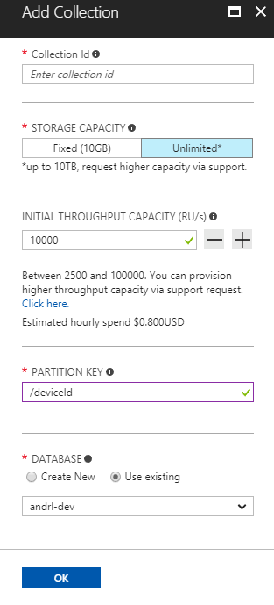
Account
Database
Container
Item
Notes:
A tenant of the Cosmos DB service starts by provisioning a database account. A database account manages one or more databases. A Cosmos DB database manages users, permissions and containers. A Cosmos DB resource container is a schema-agnostic container of arbitrary user-generated JSON items and JavaScript based stored procedures, triggers and user-defined-functions (UDFs). Entities under the tenant’s database account – databases, users, permissions, containers etc. are referred to as resources.
Each resource is uniquely identified by a stable and logical URI and represented as a JSON document. The overall resource model of an application using Cosmos DB is a hierarchical overlay of the resources rooted under the database account, and can be navigated using hyperlinks. Except for the item resource, which is used to represent arbitrary user defined JSON content, all other resources have a system-defined schema.
Container and item resources are further projected as reified resource types for a specific type of API interface. For example, while using document-oriented APIs, container and item resources are projected as collection (container) and document (item) resources, respectively; likewise, for graph-oriented API access, the underlying container and item resources are projected as graph (container), node (item) and edge (item) resources respectively; while accessing using a key-value API table (container) and item/row (item) are projected.

Slide 21
Account
Database
Container
Item
Notes:
A tenant of the Cosmos DB service starts by provisioning a database account. A database account manages one or more databases. A Cosmos DB database manages users, permissions and containers. A Cosmos DB resource container is a schema-agnostic container of arbitrary user-generated JSON items and JavaScript based stored procedures, triggers and user-defined-functions (UDFs). Entities under the tenant’s database account – databases, users, permissions, containers etc. are referred to as resources.
Each resource is uniquely identified by a stable and logical URI and represented as a JSON document. The overall resource model of an application using Cosmos DB is a hierarchical overlay of the resources rooted under the database account, and can be navigated using hyperlinks. Except for the item resource, which is used to represent arbitrary user defined JSON content, all other resources have a system-defined schema.
Container and item resources are further projected as reified resource types for a specific type of API interface. For example, while using document-oriented APIs, container and item resources are projected as collection (container) and document (item) resources, respectively; likewise, for graph-oriented API access, the underlying container and item resources are projected as graph (container), node (item) and edge (item) resources respectively; while accessing using a key-value API table (container) and item/row (item) are projected.

Slide 22
Account
Database
Container
Item
Notes:
A tenant of the Cosmos DB service starts by provisioning a database account. A database account manages one or more databases. A Cosmos DB database manages users, permissions and containers. A Cosmos DB resource container is a schema-agnostic container of arbitrary user-generated JSON items and JavaScript based stored procedures, triggers and user-defined-functions (UDFs). Entities under the tenant’s database account – databases, users, permissions, containers etc. are referred to as resources.
Each resource is uniquely identified by a stable and logical URI and represented as a JSON document. The overall resource model of an application using Cosmos DB is a hierarchical overlay of the resources rooted under the database account, and can be navigated using hyperlinks. Except for the item resource, which is used to represent arbitrary user defined JSON content, all other resources have a system-defined schema.
Container and item resources are further projected as reified resource types for a specific type of API interface. For example, while using document-oriented APIs, container and item resources are projected as collection (container) and document (item) resources, respectively; likewise, for graph-oriented API access, the underlying container and item resources are projected as graph (container), node (item) and edge (item) resources respectively; while accessing using a key-value API table (container) and item/row (item) are projected.

Slide 23
Account
Database
Container
Item
Notes:
A tenant of the Cosmos DB service starts by provisioning a database account. A database account manages one or more databases. A Cosmos DB database manages users, permissions and containers. A Cosmos DB resource container is a schema-agnostic container of arbitrary user-generated JSON items and JavaScript based stored procedures, triggers and user-defined-functions (UDFs). Entities under the tenant’s database account – databases, users, permissions, containers etc. are referred to as resources.
Each resource is uniquely identified by a stable and logical URI and represented as a JSON document. The overall resource model of an application using Cosmos DB is a hierarchical overlay of the resources rooted under the database account, and can be navigated using hyperlinks. Except for the item resource, which is used to represent arbitrary user defined JSON content, all other resources have a system-defined schema.
Container and item resources are further projected as reified resource types for a specific type of API interface. For example, while using document-oriented APIs, container and item resources are projected as collection (container) and document (item) resources, respectively; likewise, for graph-oriented API access, the underlying container and item resources are projected as graph (container), node (item) and edge (item) resources respectively; while accessing using a key-value API table (container) and item/row (item) are projected.

Slide 24
Account
Database
Container
Item
Notes:
A tenant of the Cosmos DB service starts by provisioning a database account. A database account manages one or more databases. A Cosmos DB database manages users, permissions and containers. A Cosmos DB resource container is a schema-agnostic container of arbitrary user-generated JSON items and JavaScript based stored procedures, triggers and user-defined-functions (UDFs). Entities under the tenant’s database account – databases, users, permissions, containers etc. are referred to as resources.
Each resource is uniquely identified by a stable and logical URI and represented as a JSON document. The overall resource model of an application using Cosmos DB is a hierarchical overlay of the resources rooted under the database account, and can be navigated using hyperlinks. Except for the item resource, which is used to represent arbitrary user defined JSON content, all other resources have a system-defined schema.
Container and item resources are further projected as reified resource types for a specific type of API interface. For example, while using document-oriented APIs, container and item resources are projected as collection (container) and document (item) resources, respectively; likewise, for graph-oriented API access, the underlying container and item resources are projected as graph (container), node (item) and edge (item) resources respectively; while accessing using a key-value API table (container) and item/row (item) are projected.

Slide 25
Account
Database
Container
Item
Sproc
Trigger
UDF
Notes:
A tenant of the Cosmos DB service starts by provisioning a database account. A database account manages one or more databases. A Cosmos DB database manages users, permissions and containers. A Cosmos DB resource container is a schema-agnostic container of arbitrary user-generated JSON items and JavaScript based stored procedures, triggers and user-defined-functions (UDFs). Entities under the tenant’s database account – databases, users, permissions, containers etc. are referred to as resources.
Each resource is uniquely identified by a stable and logical URI and represented as a JSON document. The overall resource model of an application using Cosmos DB is a hierarchical overlay of the resources rooted under the database account, and can be navigated using hyperlinks. Except for the item resource, which is used to represent arbitrary user defined JSON content, all other resources have a system-defined schema.
Container and item resources are further projected as reified resource types for a specific type of API interface. For example, while using document-oriented APIs, container and item resources are projected as collection (container) and document (item) resources, respectively; likewise, for graph-oriented API access, the underlying container and item resources are projected as graph (container), node (item) and edge (item) resources respectively; while accessing using a key-value API table (container) and item/row (item) are projected.

Slide 26
Account
Database
Container
Item
Sproc
Trigger
UDF
Conflict
Notes:
A tenant of the Cosmos DB service starts by provisioning a database account. A database account manages one or more databases. A Cosmos DB database manages users, permissions and containers. A Cosmos DB resource container is a schema-agnostic container of arbitrary user-generated JSON items and JavaScript based stored procedures, triggers and user-defined-functions (UDFs). Entities under the tenant’s database account – databases, users, permissions, containers etc. are referred to as resources.
Each resource is uniquely identified by a stable and logical URI and represented as a JSON document. The overall resource model of an application using Cosmos DB is a hierarchical overlay of the resources rooted under the database account, and can be navigated using hyperlinks. Except for the item resource, which is used to represent arbitrary user defined JSON content, all other resources have a system-defined schema.
Container and item resources are further projected as reified resource types for a specific type of API interface. For example, while using document-oriented APIs, container and item resources are projected as collection (container) and document (item) resources, respectively; likewise, for graph-oriented API access, the underlying container and item resources are projected as graph (container), node (item) and edge (item) resources respectively; while accessing using a key-value API table (container) and item/row (item) are projected.

Slide 27
Plan a partitioning strategy
Select a partition key for a container
Differentiate between partition keys and partition key ranges
Partition data across multiple containers
Calculate throughput distribution across partition key ranges
Control cross-partition queries
Plan for transactions

Slide 28
Logical vs Physical Partition
A physical partition:
Is a fixed amount of reserved SSD-backed storage
Combined with variable amount of CPU and memory \
Replicated for high availability
Fully managed by Azure Cosmos DB
Don't have to write complex code or manage your partitions.
Unlimited in terms of storage and throughput.
A logical partition:
partition within a physical partition that stores all the data associated with a single partition key value
Multiple logical partitions can end up in the same physical partition
logical partitions cannot grow beyond the maximum logical partition limit of 10 GB.

Slide 29
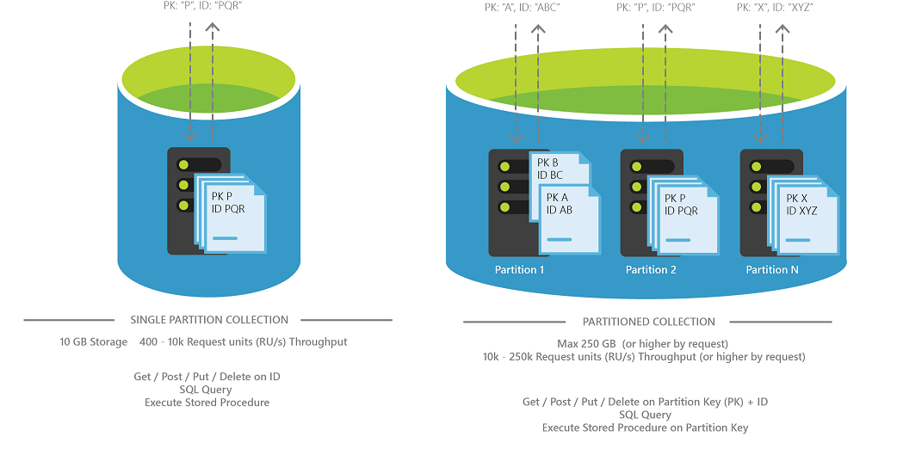
Partitioning

Slide 30
Partitioning
Cosmos DB Container (e.g. Collection)
https://docs.microsoft.com/en-us/azure/cosmos-db/partition-data
Notes:
In Azure Cosmos DB, databases are essentially containers for collections. Collections are where you place individual documents. Each collection is assigned a performance level and that performance level dictates throughput for that collection and its corresponding documents.

Slide 31
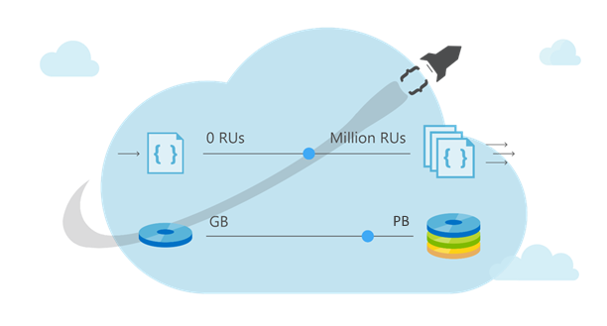
Partitioning
Cosmos DB Container (e.g. Collection)
Notes:
If a particular collection is seeing spikes in throughput, you can manage it’s performance level in isolation by increasing or decreasing the performance level. This change to the performance level of a particular collection will not cause side effects for the other collections. This allows you to adjust to meet the performance needs of any workload in isolation.
Provision small containers and they can grow

Slide 32
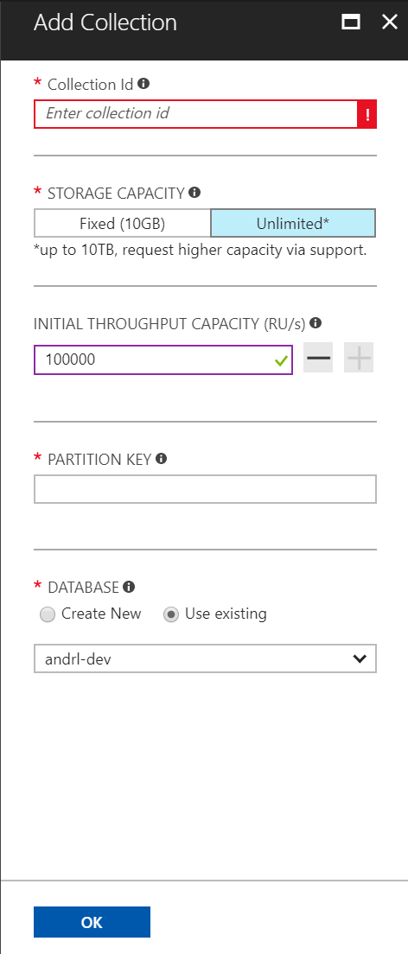
Partitioning
Cosmos DB Container (e.g. Collection)
Partitioning Scheme: top-most design decision in Cosmos DB
Notes:
Partition Key used as a logical hint on how to distribute data on underlying set of physical partitions and routing queries
No. 1 design decision

Slide 33
Partitioning
Cosmos DB Container (e.g. Collection)
Partition Key: User Id
Wide range of values
If partition fills up (all records with the same key) ~ Get an error
Fill up = 10GB
Error = “Partition key reached maximum size of 10GB”
Notes:
Azure Cosmos DB uses hash-based partitioning. When you write an item, Azure Cosmos DB hashes the partition key value and uses the hashed result to determine which partition to store the item in. Azure Cosmos DB stores all items with the same partition key in the same physical partition. The choice of the partition key is an important decision that you have to make at design time. You must pick a property name that has a wide range of values and has even access patterns. If a physical partition reaches it's storage limit and the data in the partition has the same partition key, Azure Cosmos DB returns the "Partition key reached maximum size of 10 GB" message, and the partition is not split. Choosing a good partition key is a very important decision

Slide 34
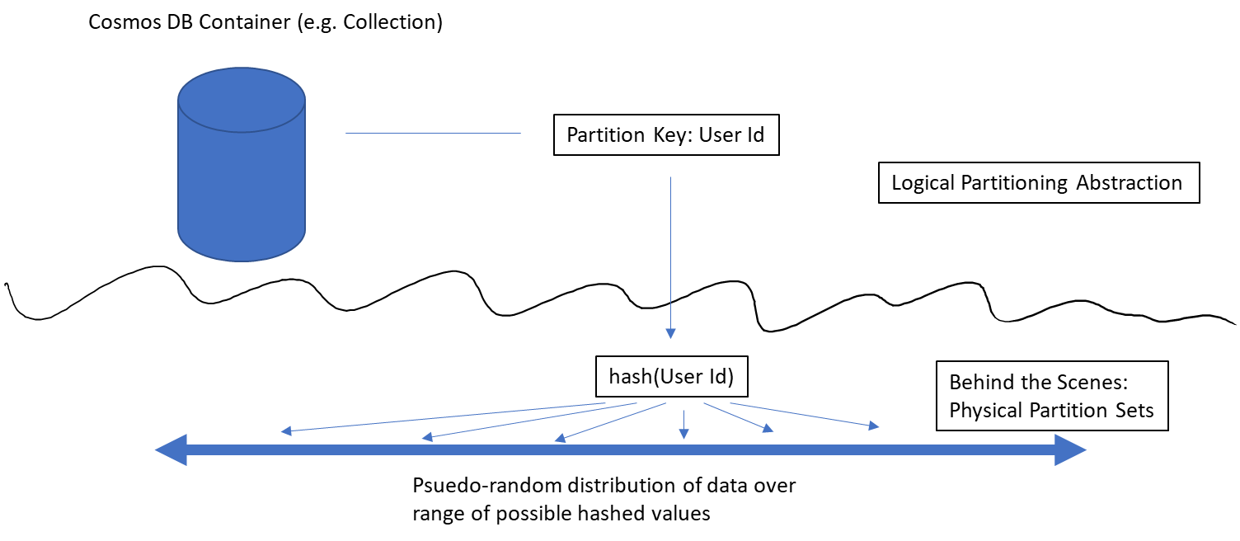
Partitioning
Notes:
A logical partition is a partition within a physical partition that stores all the data associated with a single partition key value. Multiple logical partitions can end up in the same physical partition

Slide 35
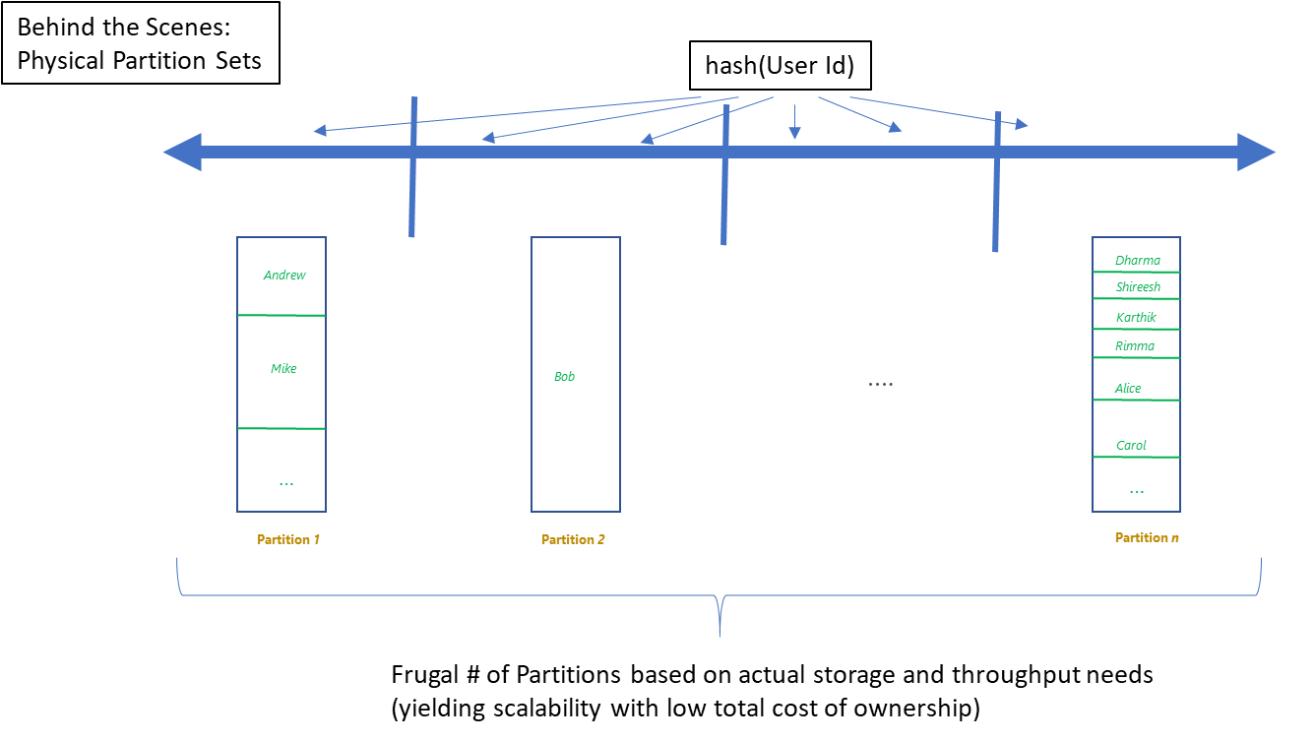
Partitioning
Notes:
4 physical partitions, no bottleneck on storage or throughput
No need to reshuffle partitions

Slide 36
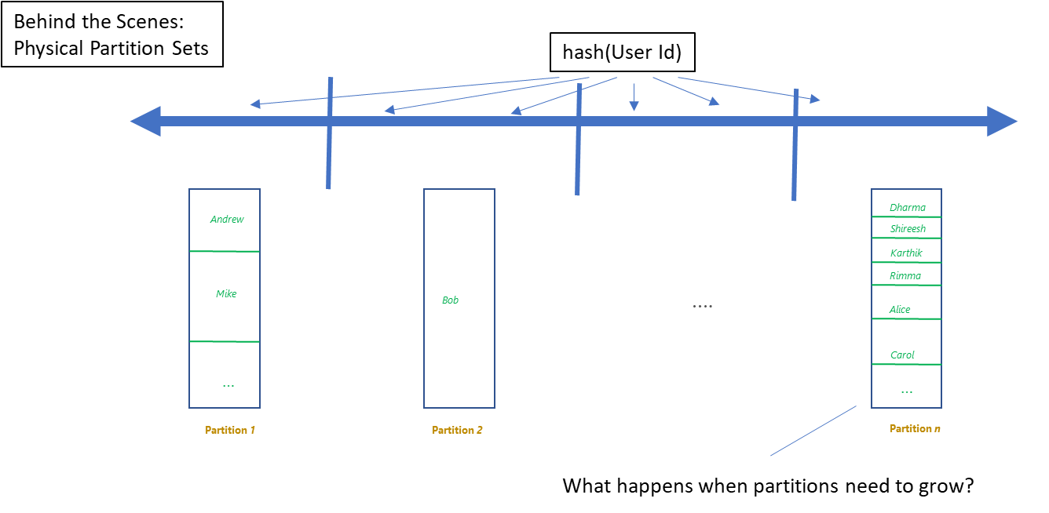
Partitioning
Notes:
Cosmos DB monitors the partition

Slide 37
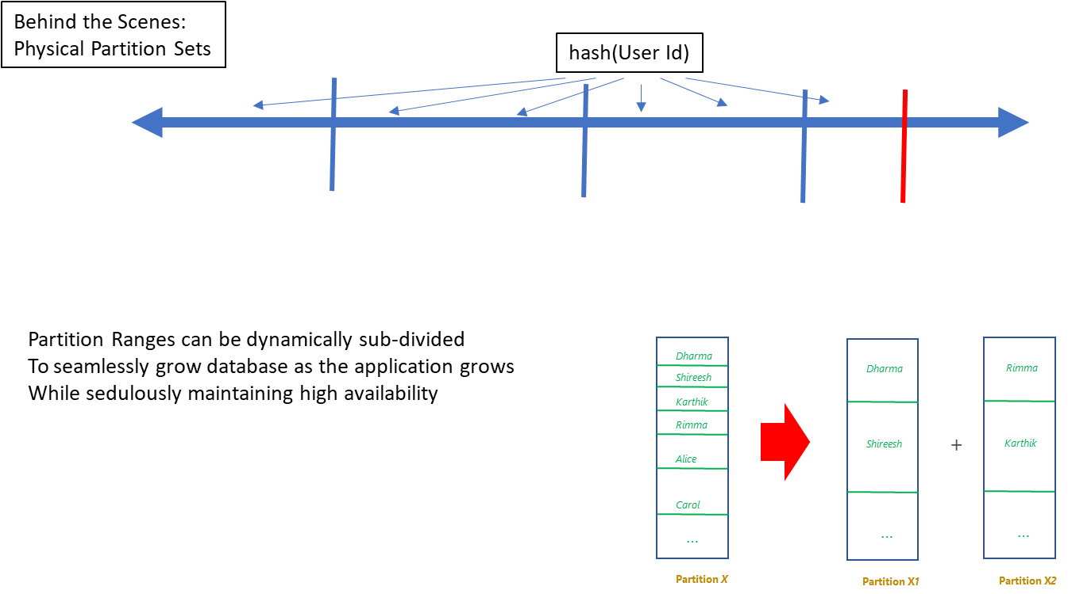
Partitioning

Slide 38
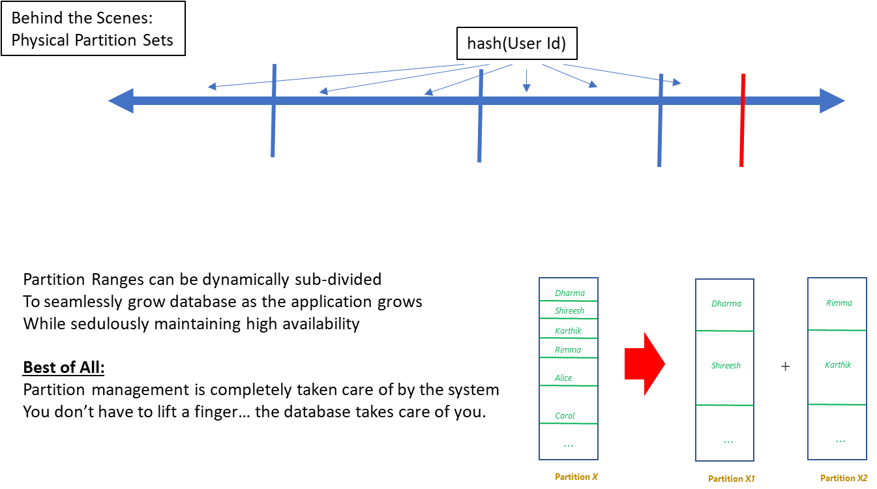
Partitioning

Slide 39
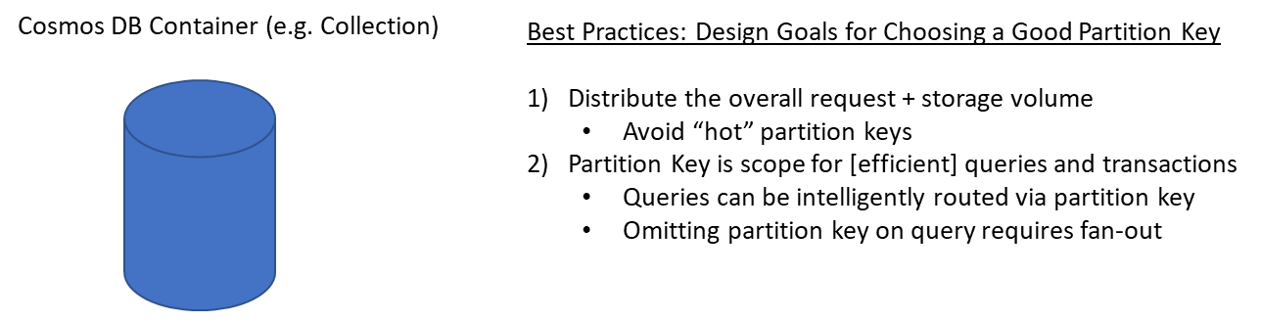
Partitioning

Slide 40
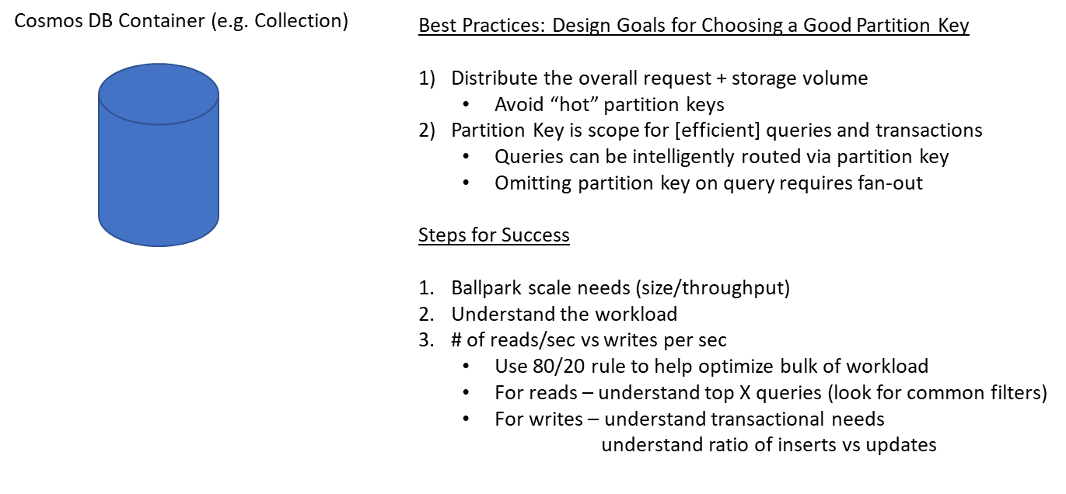
Partitioning

Slide 41
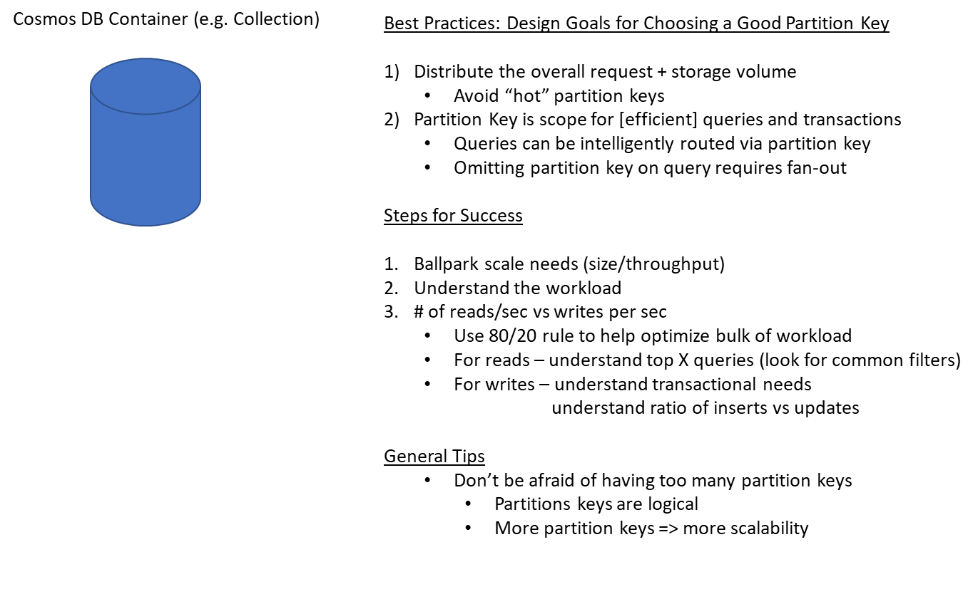
Partitioning

Slide 42
Configuring Azure Cosmos DB
Create Cosmos DB Collection
Notes:
In a new window, sign in to the Azure Portal (https://portal.azure.com).
In the Jumpbar, click New, click Databases, and then click Azure Cosmos DB.
In the New account blade, specify the desired configuration for the new Azure Cosmos DB account using the following steps:
In the ID box, enter a name to identify the Azure Cosmos DB account. When the ID is validated, a green check mark appears in the ID box.
The ID value becomes the host name within the URI. The ID may contain only lowercase letters, numbers, and the ‘-’ character, and must be between 3 and 50 characters. Note that documents.azure.com is appended to the endpoint name you choose, the result of which becomes your Azure Cosmos DB account endpoint.
In the API section, select SQL.
In the Subscription section, select the Azure subscription that you want to use for the Azure Cosmos DB account.
If your account has only one subscription, that subscription is selected by default.
In the Resource Group section, Create a new resource group for your Azure Cosmos DB account named DocDB.
Use Location to specify the geographic location closest to your current location in which to host your Azure Cosmos DB account.
Once the new Azure Cosmos DB account options are configured, click the Create button.
To check the status of the deployment, check the Notifications hub at the top-right corner of your Azure portal.
After the Azure Cosmos DB account is created, you will receive a notification in the Notifications Hub indicating that the deployment action is complete.
Download the documentdb-json-bulk.zip compressed folder and save it to your local machine.
On your local machine, extract the contents of the compressed folder to an empty directory.
You should see 50 *.json files in the directory. These files will be used later in this hands-on exercise. Please take note of the directory where you extracted these files.
Return to the browser window with the Azure Portal currently open.
In the Jumpbar, click More Services, locate the Databases section, and then click Azure Cosmos DB.
In the Azure Cosmos DB blade that opens, locate and click the Azure Cosmos DB account instance you created earlier in this module.
In the menu at the top of the Azure Cosmos DB account blade, locate and click the Add Collection button.
The blade will automatically navigate to the Data Explorer pane and show the Add Collection popup.
In the Add Collection popup, specify the following values for your new collection and database:
In the Database Id box, enter the name ecommerce.
In the Collection Id box, enter the name customers.
In the Storage Capacity section, select the Fixed (10 GB) option.
In the Throughput (400 - 10,000 RU/s) section, enter the value 400 in the numeric box.
Click the OK button.
Wait for the “Creating collection customers” operation to complete.
Once the operation has completed, locate the menu on the left-side of the Azure Cosmos DB account blade. In the menu, locate the Collections section and then click the Document Explorer option.
In the Document Explorer blade, locate the drop-down list at the top of the blade. In the list, select the customers collection within the ecommerce database.
Click the Upload button at the top of the blade.
In the Upload Document blade, locate and click the blue folder button to select files to upload.
In your operating system's file dialog, locate and select all 50 *.json files that you extracted earlier in this hands-on exercise. Click the appropriate OS-specific button to upload these files.
In the Upload Document blade, locate and click the Upload button.
Wait for the Upload operation to complete. In the File Upload Status section, you should see a Result indicating a status of Succeeded for all 50 documents.
Close the Upload Document blade.
In the Document Explorer blade, observe the 50 new documents that have been added to your collection. Click on any specific document to open a new blade with the content of the specific document.

Slide 43
Model data based on business use cases
Identify when to co-locate data within the same container or across multiple containers
Identify when to co-locate data within the same partition key or across multiple partition keys
Identify when to co-locate data within the same document or across multiple documents
Share properties between documents

Slide 44
Object Model Design
https://docs.microsoft.com/en-us/azure/cosmos-db/modeling-data
Notes:
When do I normalize and when do I not normalize

Slide 45
Containers
Containers do NOT enforce schema
There are benefits to co-locate multiple types in a container
Annotate records with a "type" property
Notes:
So, one of the things that cosmosDB everytime you create a collection, $24
So if you need to organize and separate then it is very large
Co-locating is not bad. As long as you aren’t filling it up
Table is not a container, don’t be afraid to put things together

Slide 46
Containers
Co-locating types in the same container
Ability to query across multiple entity types with a single network request.

Slide 47
Containers
Ability to query across multiple entity types with a single network request.
For example, we have two types of documents: cat and person.
{
"id": "Ralph",
"type": "Cat",
"familyId": "Liu",
"fur": {
"length": "short",
"color": "brown"
}
}
{
"id": "Andrew",
"type": "Person",
"familyId": "Liu",
"worksOn": "Azure Cosmos DB"
}
Notes:
If there is a person document.

Slide 48
Containers
Ability to query across multiple entity types with a single network request.
For example, we have two types of documents: cat and person.
{
"id": "Andrew",
"type": "Person",
"familyId": "Liu",
"worksOn": "Azure Cosmos DB"
}
{
"id": "Ralph",
"type": "Cat",
"familyId": "Liu",
"fur": {
"length": "short",
"color": "brown"
}
}
We can query both types of documents without needing a JOIN simply by running a query without a filter on type:
SELECT * FROM c WHERE c.familyId = "Liu"
Notes:
We don’t need to separate them.

Slide 49
Containers
Ability to query across multiple entity types with a single network request.
For example, we have two types of documents: cat and person.
{
"id": "Andrew",
"type": "Person",
"familyId": "Liu",
"worksOn": "Azure Cosmos DB"
}
{
"id": "Ralph",
"type": "Cat",
"familyId": "Liu",
"fur": {
"length": "short",
"color": "brown"
}
}
If we wanted to filter on type = “Person”, we can simply add a filter on type to our query:
SELECT * FROM c WHERE c.familyId = "Liu" AND c.type = "Person"

Slide 50
Containers
Co-locating types in the same container
Ability to query across multiple entity types with a single network request
Ability to perform transactions across multiple types
Cost: reduce physical partition footprint*
Notes:
*point-in-time (current date is 12/7/2017); we have roadmap items to make collection cost friendlier

